Slide 1

Lecture 6 Database Design and the E-R Model
Prof. Jihong Guan
Email: jhguan@tongji.edu.cn
Department of Computer Science and Technology
Tongji University

Slide 2
Outline of the Course
Part 0: Overview
Ch1: Introduction
Part 1 Relational Databases
Ch2: Relational model (data model, relational algebra)
Ch3&4: SQL(Structured Query Language)
Ch5: Advanced SQL
☞ Part 2 Database Design
Ch6: Database design based on E-R model
Ch7: Relational database design
Part 3 Application Design & Development
Ch8: Complex data types
Ch9: Application development
Part 4 Big data analytics
Ch10: Big data
Ch11: Data analytics
Part 5 Data Storage & Indexing
Ch12: Physical storage system
Ch13: Data storage structure
Ch14: Indexing
Part 6 Query Processing & Optimization
Ch15: Query processing
Ch16: Query optimization
Part 7 Transaction Management
Ch17: Transactions
Ch18: Concurrency control
Ch19: Recovery system
Part 8 Parallel & Distributed Database
Ch20: Database system architecture
Ch21-23: Parallel & distributed storage, query processing & transaction processing
Part 9
DB Platform:OceanBase, MongoDB, Neo4J

Slide 3
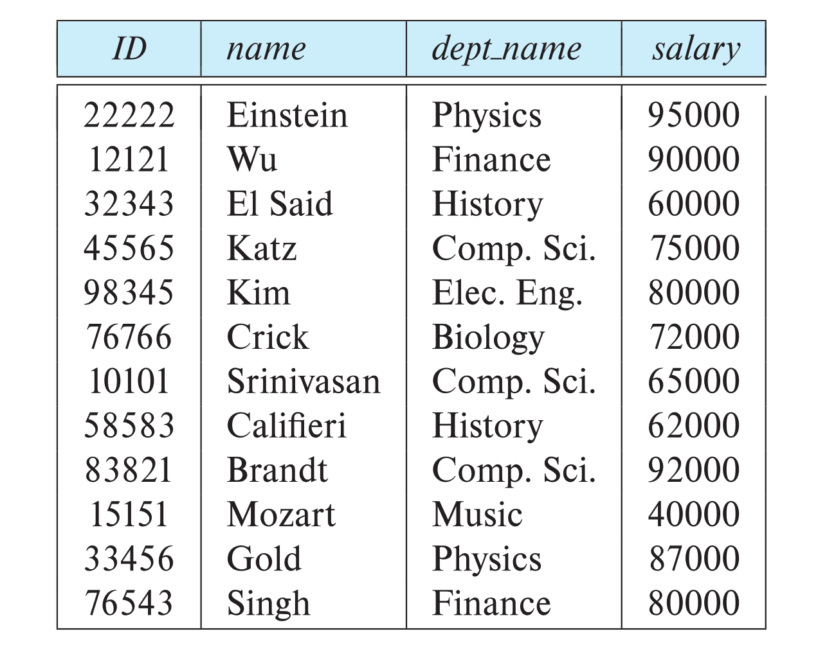
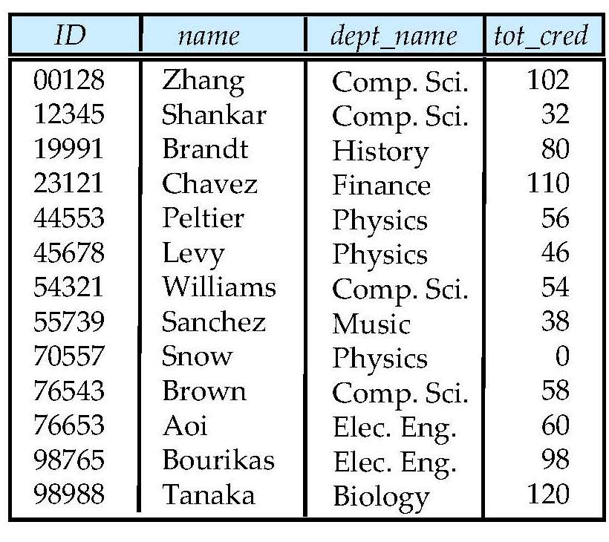
University Database
Instructor table
Student table

Slide 4
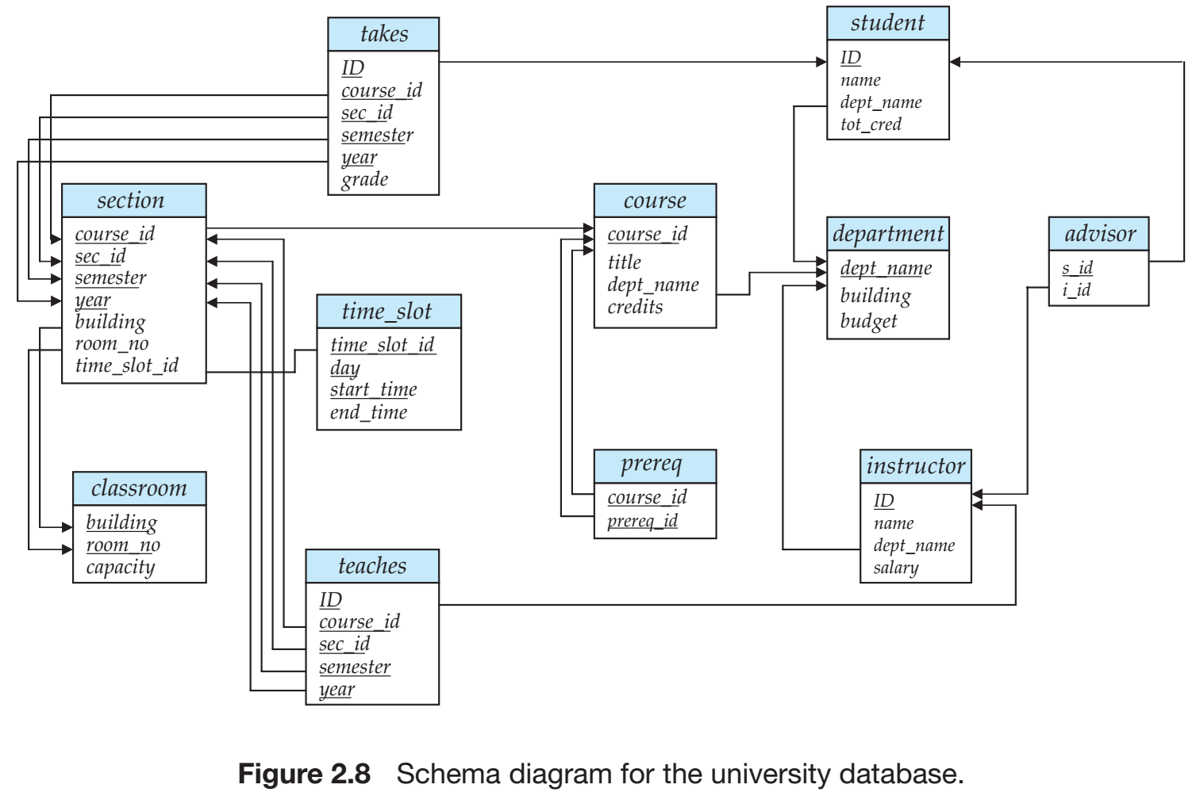
University Database
Relational Model
SQL
Database Design
Storage & Query
Transactions

Slide 5
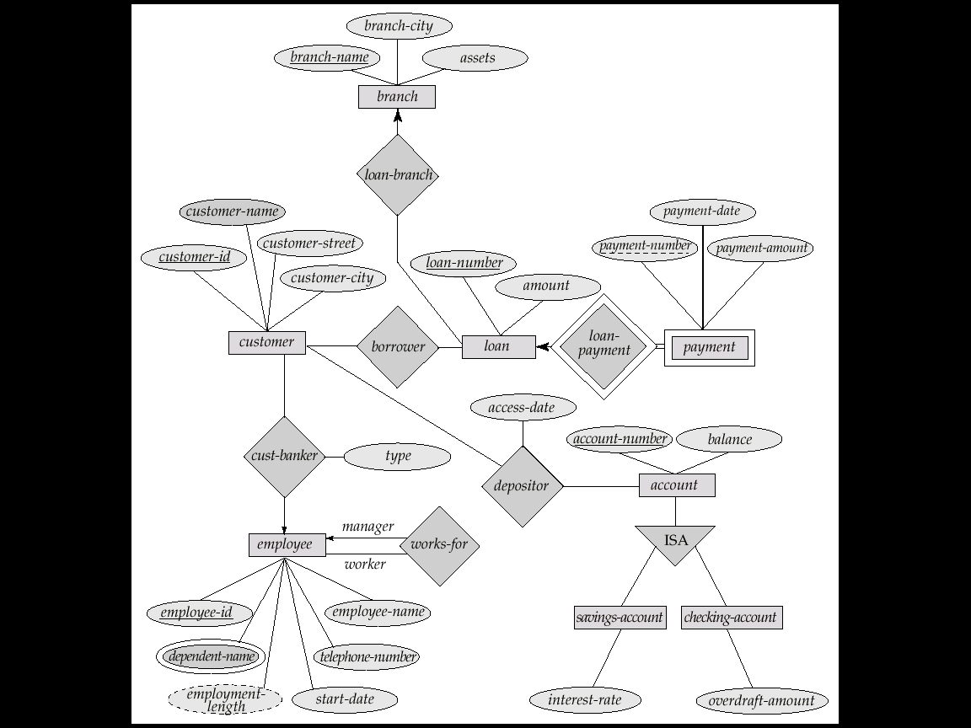
E-R Diagram for a Banking Enterprise
account-branch
Weak entity sets
multi-valued attribute
derived attribute

Slide 6
The Banking Schema
branch = (branch_name, branch_city, assets)
customer = (customer_id, customer_name, customer_street, customer_city)
loan = (loan_number, amount)
account = (account_number, balance)
employee = (employee_id, employee_name, telephone_number, start_date)
dependent_name = (employee_id, dname) (derived from a multivalued attribute)
account_branch = (account_number, branch_name)
loan_branch = (loan_number, branch_name)
borrower = (customer_id, loan_number)
depositor = (customer_id, account_number, access_date)
cust_banker = (customer_id, employee_id, type)
works_for = (worker_employee_id, manager_employee_id)
payment =(loan_number,payment_number,payment_date,payment_amount)
savings_account = (account_number, interest_rate)
checking_account = (account_number, overdraft_amount)

Slide 7
Outline
☞ Overview of the Design Process
Entity-Relationship Model (实体联系模型)
Constraints
Entity-Relationship Diagrams (实体联系图)
Reduction to Relation Schemas
Summary

Slide 8
开发数据库应用包含的任务
用户需求
设计数据库模式
设计访问和更新数据的程序
设计控制数据访问的安全模式
关系（表）
关系的属性
约束

Slide 9
Data Abstraction
Real Word
Abstraction
Real world Conceptual model
Database Designers
Information world
Conceptual model
Conceptual model Logical model
Database Designers
Data model supported
by DBMS
Machine World
Logical model Physical model
DBMS

Slide 10
Database Design (数据库设计)
Conceptual design(概念设计)
Mapping a real world organization to a conceptual model
Logical design(逻辑设计)
Transforming the conceptual model to a logical model
Physical design(物理设计)
Instantiating the logical model to physical organization and storage
Notes:
Instantiating：实例化

Slide 11
Database Design (Cont.)
Understand the real-world domain being modeled
Specify it using a database design model
Design models are especially convenient for schema design, but are not necessarily implemented by DBMS
Entity/Relationship (E/R) model
Object Definition Language (ODL)
Translate specification to the data model of DBMS
Relational, XML, object-oriented, etc.
Create the DBMS schema

Slide 12
Outline
Overview of the Design Process
☞ Entity-Relationship Model (实体联系模型)
Constraints
Entity-Relationship Diagrams (实体联系图)
Reduction to Relation Schemas
Summary

Slide 13
E-R Diagram for a Banking Enterprise
account-branch
Weak entity sets
multi-valued attribute
derived attribute

Slide 14
大学E-R图

Slide 15
Database Conceptual Design
Conceptual design (ER Model is used at this stage)
What are the entities and relationships?
What information about these entities and relationships should we store in the database?
What are the integrity constraints or business rules that should hold?
A database ‘schema’ in the ER Model can be represented pictorially using ER diagram
Can map an ER diagram into a relational schema
Notes:
Pictorially：绘画般地

Slide 16
ER Model: A General View
Historically very popular
A “watered-down” object-oriented design model
ER diagrams represent designs
Primarily a design model—not implemented by any major DBMS
Three concepts
Entity set
Attributes
Relationship sets
Notes:
“watered-down”：淡化了的

Slide 17

Peter Pin-Shan Chen（陈品山）
Dr. Peter P. Chen is the originator of the Entity-Relationship Model (ER Model), and the founder of ER international conference
The ER Model serves as the foundation of many systems analysis and design methodologies, computer-aided software engineering (CASE) tools, and repository systems
Peter Chen, The Entity-Relationship Model--Toward a Unified View of Data ACM Transactions on Database Systems, Vol. 1, No. 1, March 1976, Pages 9 - 36

Slide 18
Entity Sets（实体集）
A database can be modeled as
a collection of entities
relationship among entities
An entity is an object that exists and is distinguishable from other objects
E.g., specific person, company, event, university
Entities have attributes
E.g., people have names and addresses
An entity set is a set of entities of the same type that share the same properties
E.g., the set of all persons, companies, trees, holidays
Extension of the entity set (实体集的外延) is the actual collection of entities belonging to the entity set
Notes:
An entity set（一个实体或关系） is a set of entities of the same type that share the same properties, or attributes. The set of all people who are instructors at a given university, for example, can be defined as the entity set instructor. Similarly, the entity set student might represent the set of all students in the university.
extension of the entity set to refer to the actual collection of entities belonging to the entity set. Thus, the set of actual instructors in the university forms the extension of the entity set instructor. The above distinction is similar to the difference between a relation and a relation instance

Slide 19
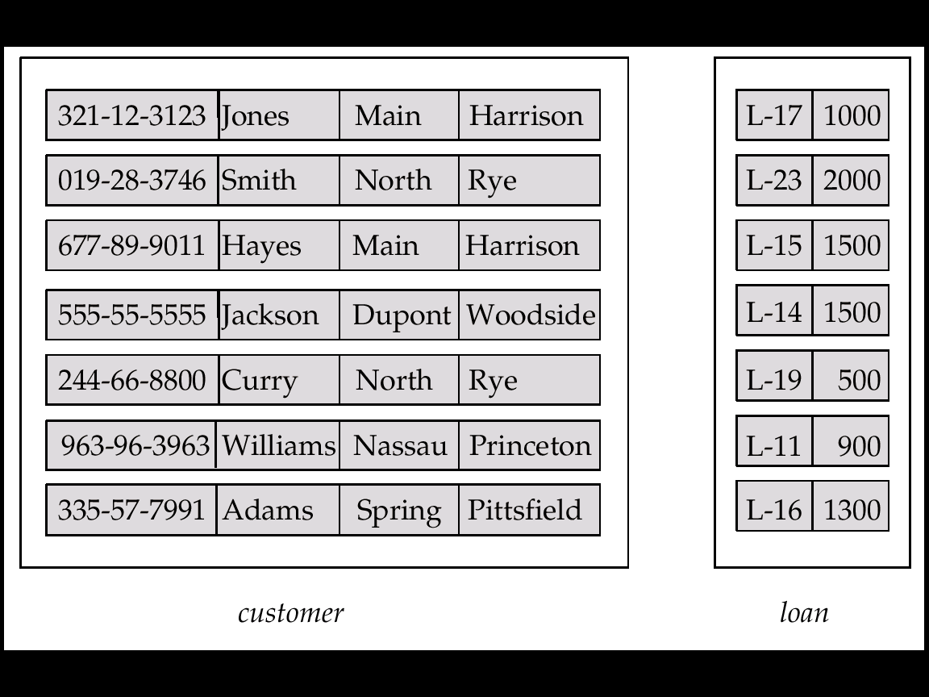
Entity Sets customer and loan
Customer_ customer_ customer_ customer_ loan_ amount id name street city number

Slide 20
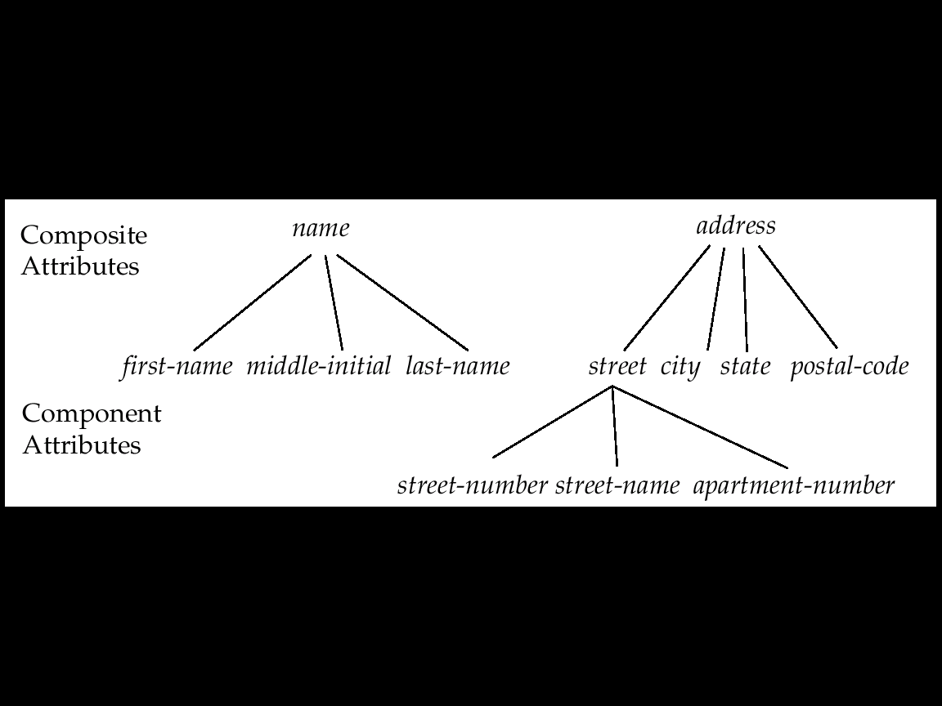
Attributes（属性）
An entity is represented by a set of attributes, that is descriptive properties possessed by all members of an entity set
customer (customer_id, customer_name, customer_street, customer_city) loan (loan_number, amount)
Domain (域) – the set of permitted values for each attribute
Attribute types
Simple and composite attributes (复合属性)
Single-valued and multi-valued attributes
Derived attributes
Notes:
a composite attribute may appear as a hierarchy . upper and lower bounds may be placed on the number of values in a multivalued attribute. For example, a university may limit the number of phone numbers recorded for a single instructor to two.
The value of a derived attribute is not stored but is computed when required.

Slide 21
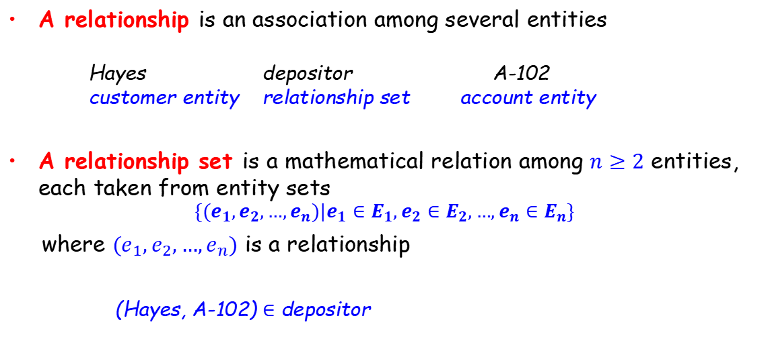
Relationship Sets (联系集)
A relationship is an association among several entities
Hayes depositor A-102 customer entity relationship set account entity
A relationship set is a mathematical relation among $n≥2$ entities, each taken from entity sets
$$\{(e_{1},e_{2},…,e_{n})|e_{1}∈E_{1},e_{2}∈E_{2},…,e_{n}∈E_{n}\}$$
where $(e_{1},e_{2},…,e_{n})$ is a relationship
(Hayes, A-102) $∈$ depositor

Slide 22
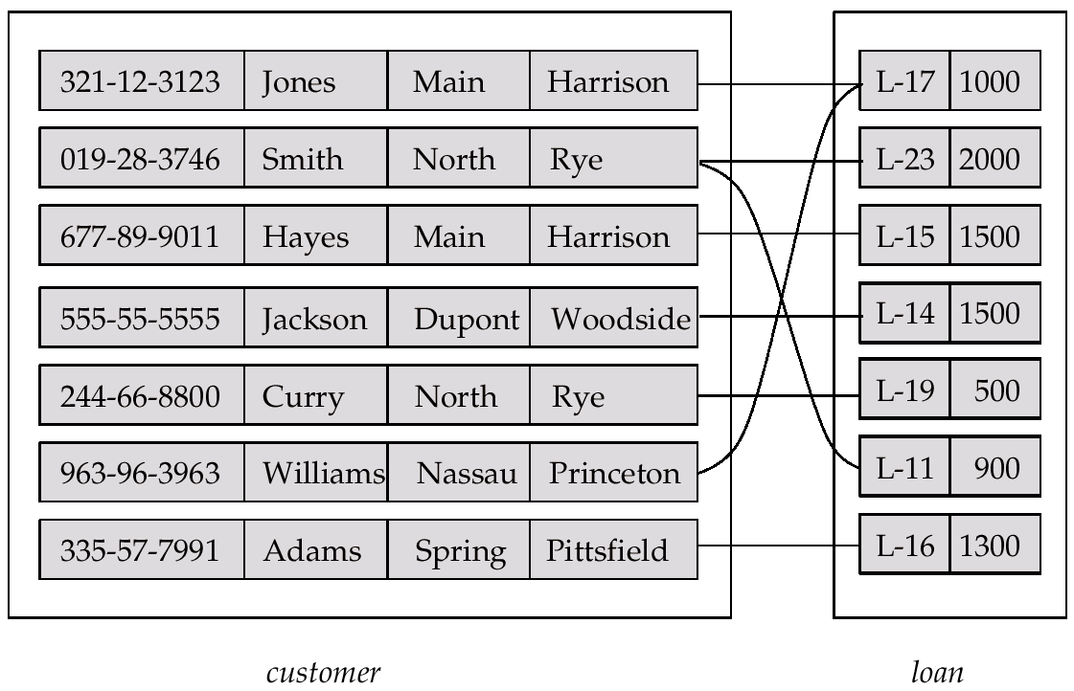
Relationship Set borrower

Slide 23
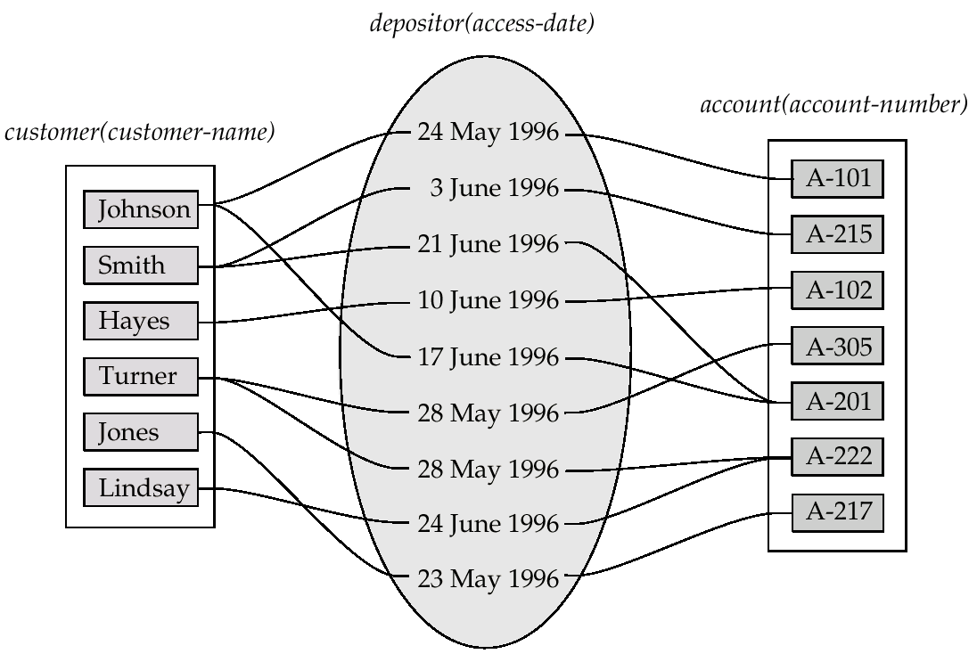
Relationship Sets (Cont.)
An attribute can also be property of a relationship set
For instance, the depositor relationship set between entity sets customer and account may have the attribute access-date

Slide 24
Degree (度/阶) of a Relationship Set
The number of entity sets that participate in a relationship set
Relationship sets that involve two entity sets are binary (二元的)
Relationship sets may involve more than two entity sets
Relationships between more than two entity sets are rare, and most relationships are binary

Slide 25
Outline
Overview of the Design Process
Entity-Relationship Model (实体联系模型)
☞ Constraints
Entity-Relationship Diagrams (实体联系图)
Reduction to Relation Schemas
Summary

Slide 26
Mapping Cardinalities (映射基数)
Express the number of entities to which another entity can be associated via a relationship set
For a binary relationship set, the mapping cardinality must be one of the following types
One to one (1对1): An entity in A is associated with at most one entity in B, and an entity in B is associated with at most one entity in A
One to many (1对多): An entity in A is associated with any number (zero or more) of entities in B. An entity in B, however, can be associated with at most one entity in A
Many to one (多对1): An entity in A is associated with at most one entity in B. An entity in B, however, can be associated with any number (zero or more) of entities in A
Many to many (多对多): An entity in A is associated with any number (zero or more) of entities in B, and an entity in B is associated with any number (zero or more) of entities in A

Slide 27
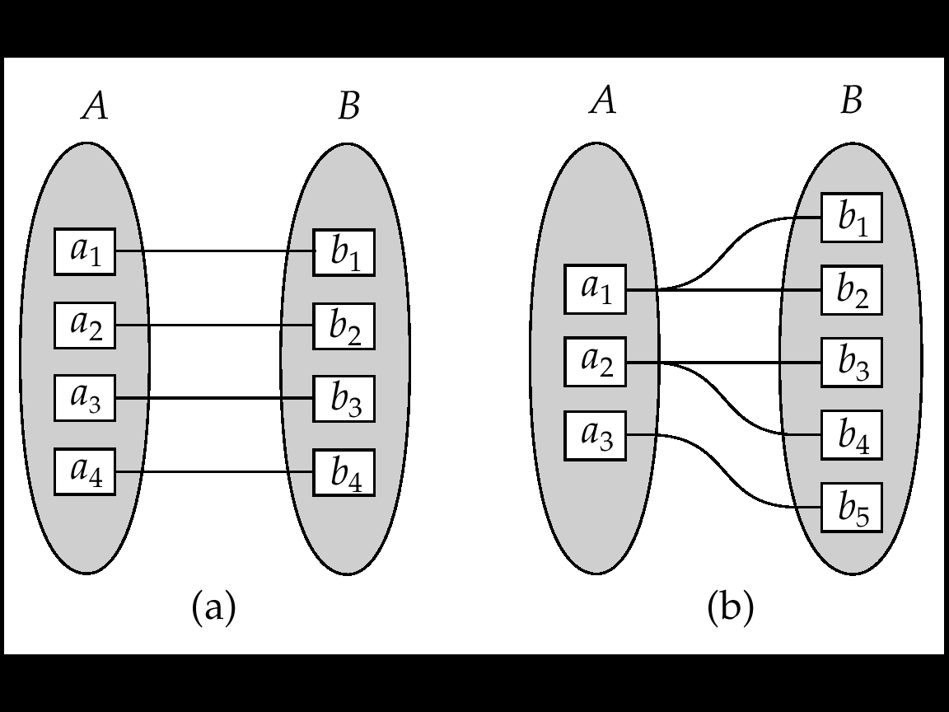
Mapping Cardinalities (cont.)
Mapping cardinality types:
One to one(1对1): An entity in A is associated with at most one entity in B, and an entity in B is associated with at most one entity in A.
One to many(1对多): An entity in A is associated with any number (zero or more) of entities in B. An entity in B, however, can be associated with at most one entity in A.
One to one
One to Many
Note: Some elements in A and B may not be mapped to any elements in the other set

Slide 28
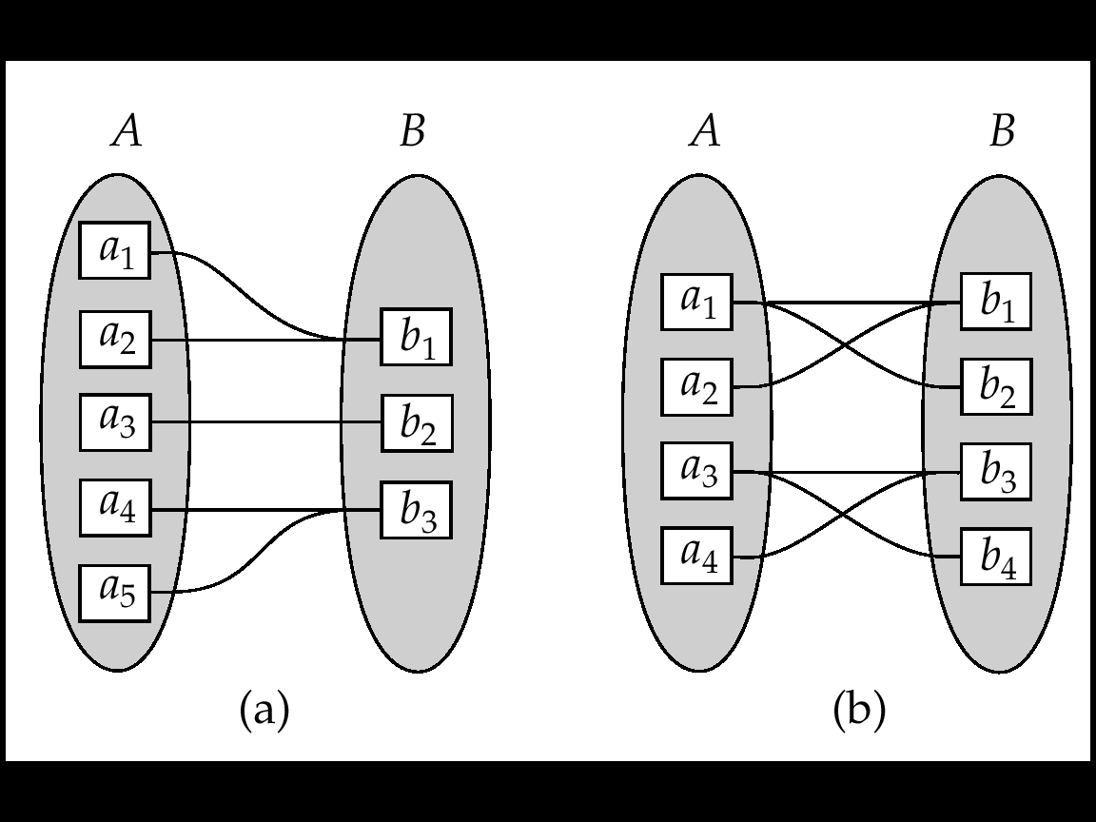
Mapping Cardinalities (cont.)
Mapping cardinality types:
Many to one(多对1): An entity in A is associated with at most one entity in B. An entity in B, however, can be associated with any number (zero or more) of entities in A.
Many to many(多对多): An entity in A is associated with any number (zero or more) of entities in B, and an entity in B is associated with any number (zero or more) of entities in A.
Many to one
Many to many
Note: Some elements in A and B may not be mapped to any elements in the other set

Slide 29
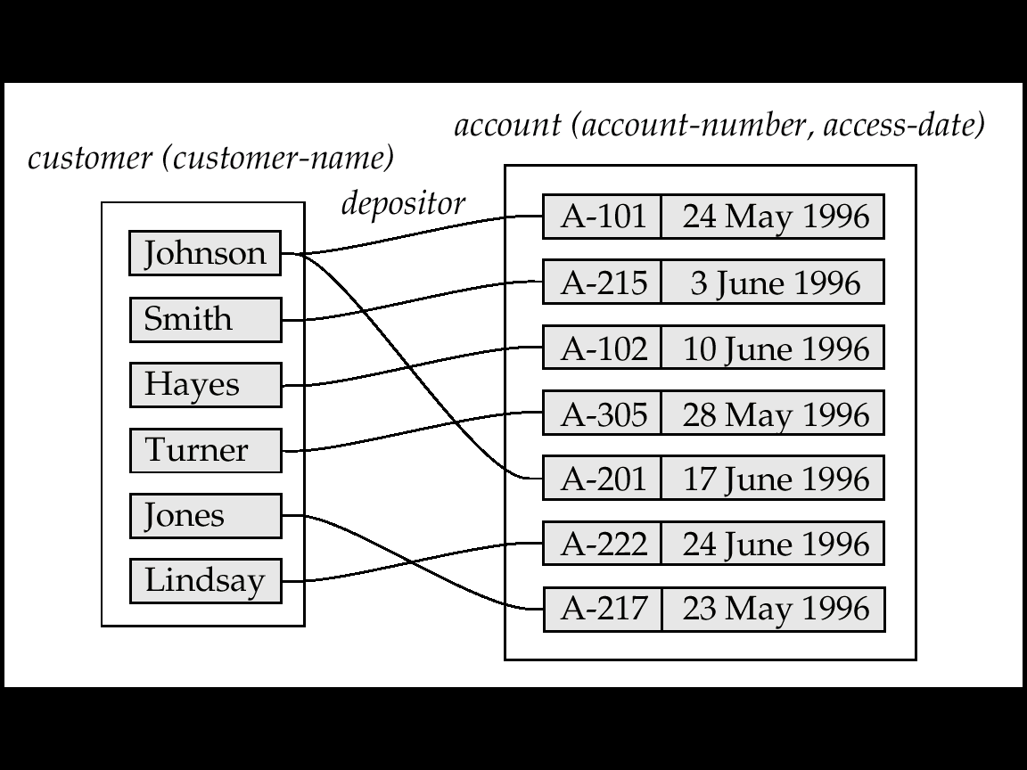
Mapping Cardinalities affect ER Design
Can make access-date an attribute of account, instead of a relationship attribute, if each account can have only one customer

Slide 30
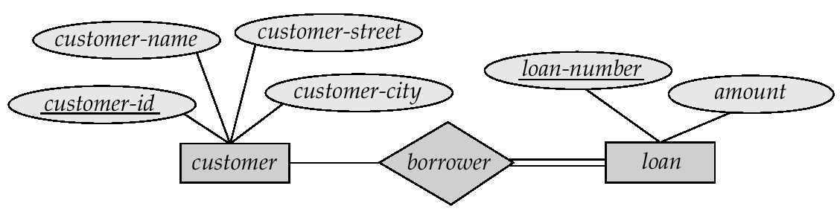
Participation Constraints (参与约束)
Total participation (indicated by double line):
Every entity in the entity set participates in at least one relationship in the relationship set
E.g., 每个student实体通过advisor联系同至少一名教师相联系，student在联系集advisor中是全部参与
Partial participation
Some entities may not participate in any relationship in the relationship set
E.g., 有的instructor可能不指导学生，所以instructor在联系集advisor中是部分参与

Slide 31
Outline
Overview of the Design Process
Entity-Relationship Model (实体联系模型)
Constraints
☞ Entity-Relationship Diagrams (实体联系图)
Reduction to Relation Schemas
Summary

Slide 32
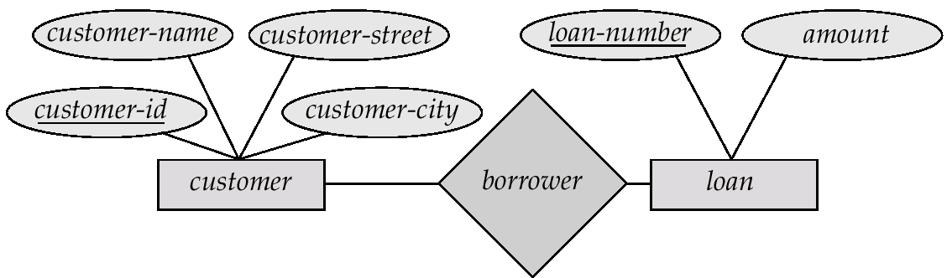
Entity-Relationship Diagrams
Rectangles represent entity sets
Diamonds represent relationship sets.
Lines link attributes to entity sets and entity sets to relationship sets.
Ellipses represent attributes
Double ellipses represent multi-valued attributes
Dashed ellipses denote derived attributes
Underline indicates primary key attributes

Slide 33
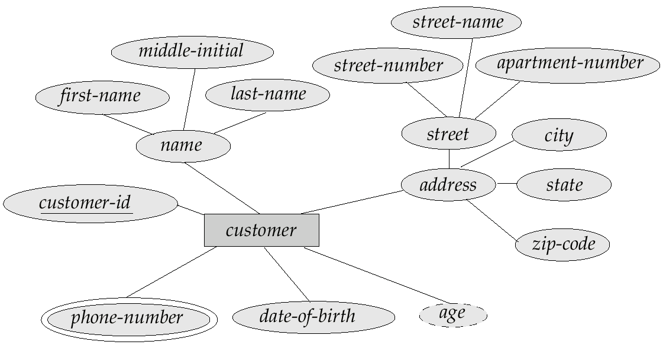
E-R Diagram
E-R Diagram with composite, multivalued, and derived attributes
composite attribute
derived attribute
multi-valued attribute

Slide 34
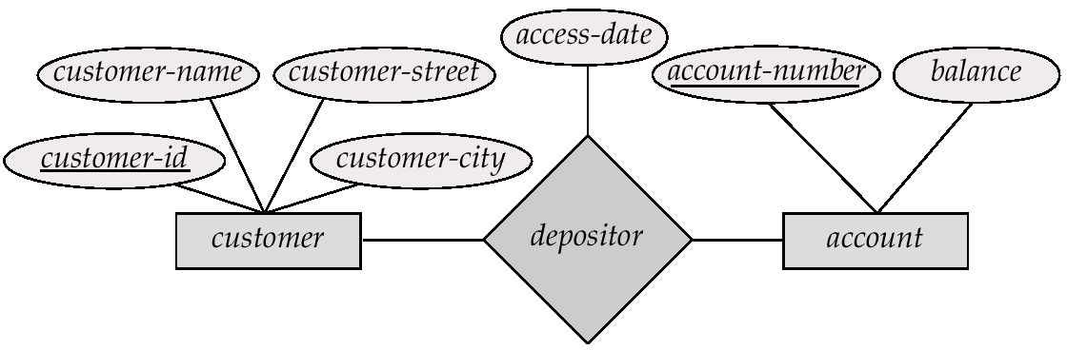
Relationship Sets with Attributes

Slide 35
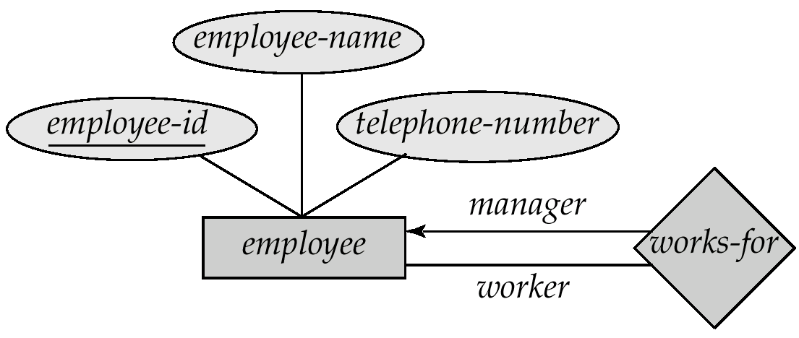
Roles (角色)
Entity sets of a relationship need not be distinct
The labels “manager” and “worker” are called roles; they specify how employee entities interact via the works-for relationship set
Role labels are optional and used to clarify semantics of the relationship

Slide 36
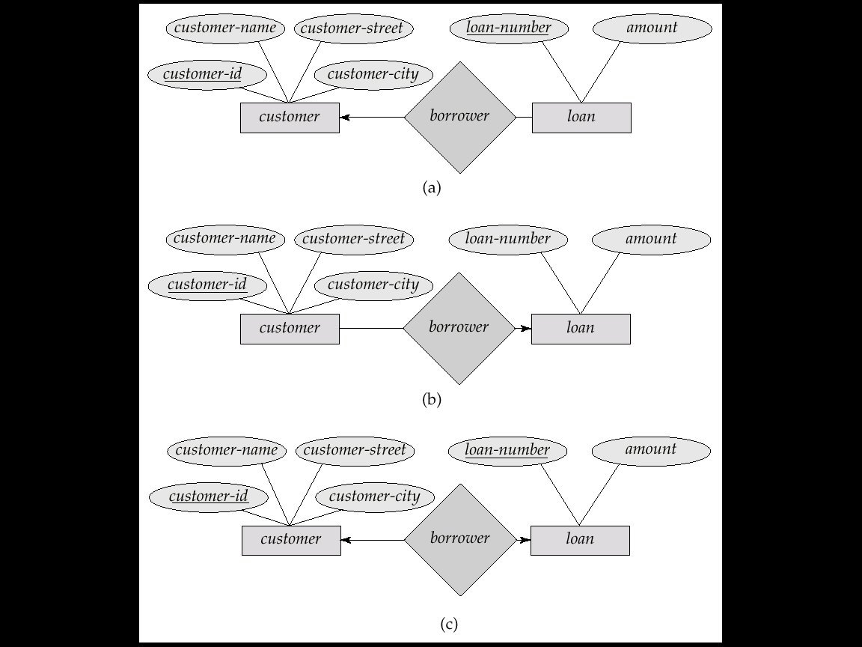
Cardinality Constraints
We express cardinality constraints by drawing either a directed line (→), signifying “one,” or an undirected line (—), signifying “many,” between the relationship set and the entity set.
One-to-one relationship
A customer is associated with at most one loan via the relationship borrower
A loan is associated with at most one customer via borrower

Slide 37
One-To-Many Relationship
One-to-many relationship
a loan is associated with at most one customer via borrower
a customer is associated with several (including 0) loans via borrower

Slide 38
Many-To-One Relationships
Many-to-one relationship
a loan is associated with several (including 0) customers via borrower
a customer is associated with at most one loan via borrower

Slide 39
Many-To-Many Relationship
Many-to-many relationship
a customer is associated with several (possibly 0) loans via borrower
a loan is associated with several (possibly 0) customers via borrower

Slide 40
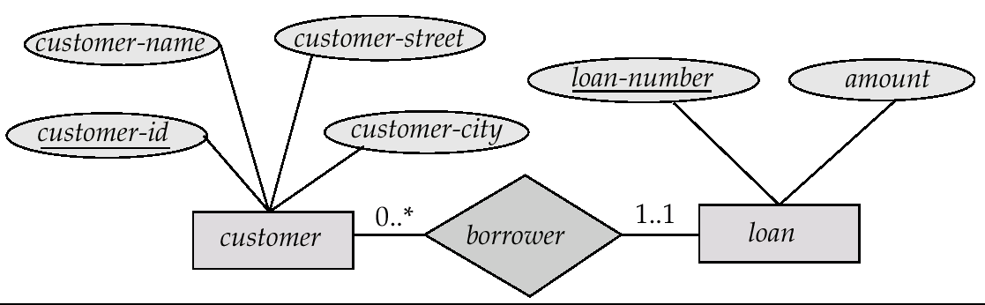

Alternative Notation for Cardinality Limits
Cardinality limits can also express participation constraints
Notation: $m$..$n$, where $m$ and $n$ are the minimum and maximum cardinalities respectively

Slide 41
Keys (键/码)
A super key (超键) of an entity set is a set of one or more attributes whose values uniquely determine each entity
A candidate key (候选键) of an entity set is a minimal super key
customer_id is a candidate key of customer
account_number is a candidate key of account
Although several candidate keys may exist, one of the candidate keys is selected to be the primary key (主键)

Slide 42
Keys for Relationship Sets
The combination of primary keys of the participating entity sets forms a super key of a relationship set
(customer_id, account_number) is the super key of depositor
Must consider the mapping cardinality of the relationship set when deciding what are the candidate keys
Need to consider semantics of relationship set in selecting the primary key in case of more than one candidate key
Notes:
Suppose that the relationship set is many-to-many. Then the primary key of advisor consists of the union of the primary keys of instructor and student. If the relationship is many-to-one from student to instructor—that is, each student can have at most one advisor—then the primary key of advisor is simply the primary key of student. However, if an instructor can advise only one student— that is, if the advisor relationship is many-to-one from instructor to student—then the primary key of advisor is simply the primary key of instructor. For one-to-one relationships either candidate key can be used as the primary key.

Slide 43
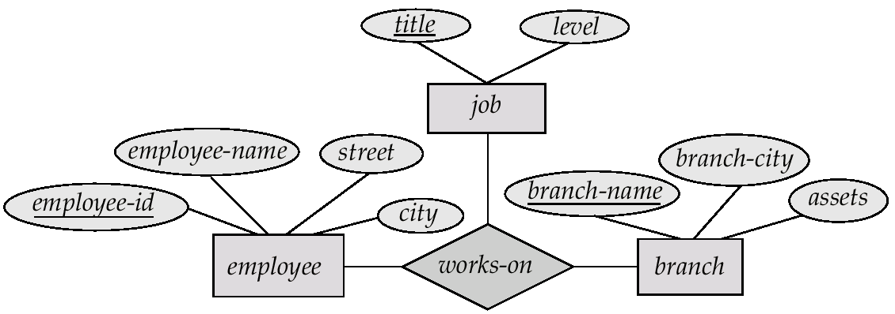
E-R Diagram with a Ternary Relationship

Slide 44
Cardinality Constraints on Ternary Relationship
We allow at most one arrow out of a ternary relationship
E.g., an arrow from works-on to job indicates that each employee works on at most one job at any branch
If there is more than one arrow, there are two ways of defining the meaning
E.g., a ternary relationship R between A, B and C with arrows to B and C
To avoid confusion we outlaw more than one arrow
Notes:
Suppose there is a relationship set R between entity sets A1, A2, . . ., An, and the only arrows are on the edges to entity sets Ai+1, Ai+2, . . ., An. Then, the two possible interpretations are: 1. A particular combination of entities from A1, A2, . . . , Ai can be associated with at most one combination of entities from Ai+1, Ai+2, . . . , An. Thus, the primary key for the relationship R can be constructed by the union of the primary keys of A1, A2, . . . , Ai. 关系集R的主码可以用A1,A2,…,Ai的主码的并集来构造 2. For each entity set Ak, i < k ≤ n, each combination of the entities from the other entity sets can be associated with at most one entity from Ak. Each set {A1, A2, . . ., Ak-1, Ak+1, . . ., An}, for i < k ≤ n, then forms a candidate key. 关系集R的候选码可以用{A1, A2, . . ., Ak-1, Ak+1, . . ., An}来构造

Slide 45
Binary vs. Non-Binary Relationships
Some relationships that appear to be non-binary may be better represented using binary relationships
E.g. A ternary relationship parents, relating a child to his/her father and mother, is best replaced by two binary relationships, father and mother
Using two binary relationships allows partial information (e.g. only mother being know)
But there are some relationships that are naturally non-binary
E.g. works-on

Slide 46
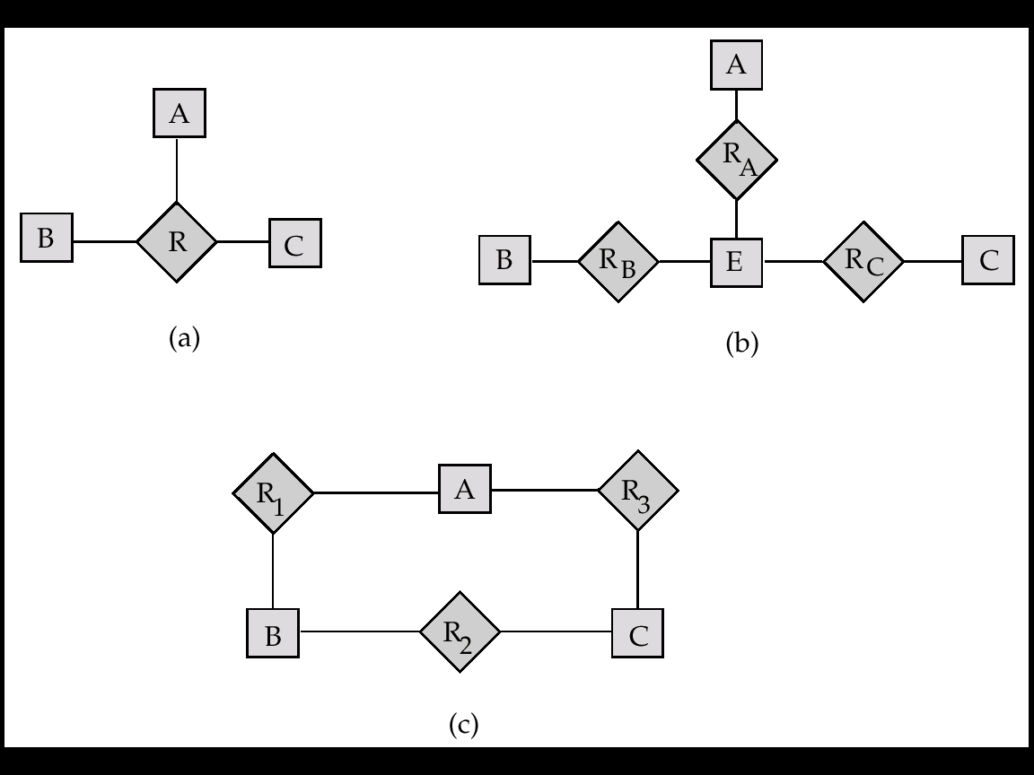
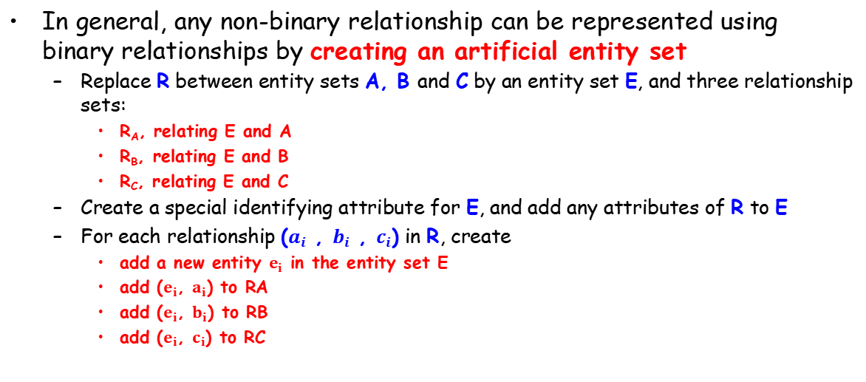
Converting Non-Binary Relationships
In general, any non-binary relationship can be represented using binary relationships by creating an artificial entity set
Replace R between entity sets A, B and C by an entity set E, and three relationship sets:
R_{A}, relating E and A
R_{B}, relating E and B
R_{C}, relating E and C
Create a special identifying attribute for E, and add any attributes of R to E
For each relationship ($a_{i}$ , $b_{i}$ , $c_{i}$) in R, create
add a new entity $e_{i}$ in the entity set E
add ($e_{i}$, $a_{i}$) to RA
add ($e_{i}$, $b_{i}$) to RB
add ($e_{i}$, $c_{i}$) to RC

Slide 47
Converting Non-Binary Relationships (Cont.)
Translate constraints
Translating all constraints may not be possible
There may be instances in the translated schema that cannot correspond to any instance of R
We can avoid creating an identifying attribute by making E a weak entity set (described shortly) identified by the three relationship sets

Slide 48
Weak Entity Sets（弱实体集）
An entity set that does not have a primary key is referred to as a weak entity set
The existence of a weak entity set depends on the existence of an identifying entity set
Identifying relationship depicted using a double diamond
The discriminator (partial key, 分辨符)
The primary key of a weak entity set
Discriminator plus primary keys of identifying entity sets

Slide 49
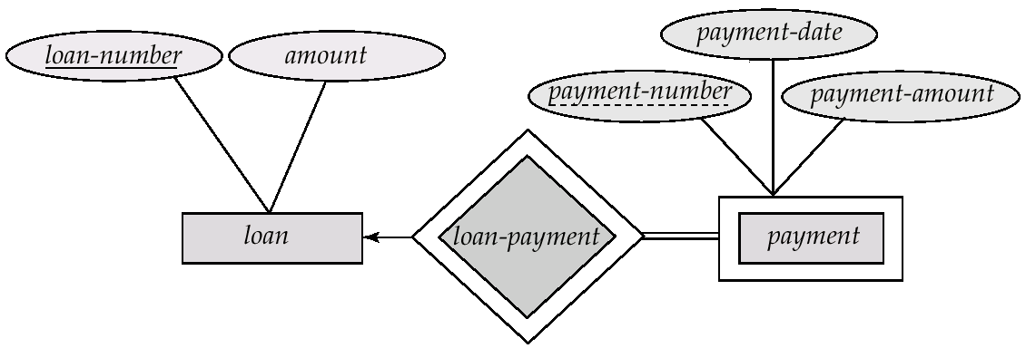
Weak Entity Sets (Cont.)
Depict a weak entity set by double rectangles.
Underline the discriminator (分辨符) of a weak entity set with a dashed line.
Payment_number – discriminator of the payment entity set
Primary key for payment – (loan_number, payment_number)
Notes:
The figure also illustrates the use of double lines to indicate total participation （完全参与）; the participation of the (weak) entity set section in the relationship sec course is total, meaning that every section must be related via sec course to some course. Finally, the arrow from sec_course to course indicates that each section is related to a single course. A weak entity set may be more appropriately modeled as an attribute if it participates in only the identifying relationship, and if it has few attributes. Conversely, a weak entity set representation more aptly （恰当地） models a situation where the set participates in relationships other than the identifying relationship, and where the weak entity set has several attributes.

Slide 50
Weak Entity Sets (Cont.)
Note: the primary key of the strong entity set is not explicitly stored with the weak entity set, since it is implicit in the identifying relationship.
If loan_number were explicitly stored, payment could be made a strong entity

Slide 51
More Weak Entity Set Examples
In a university, a course is a strong entity and a course_offering can be modeled as a weak entity
The discriminator of course_offering would be semester (including year) and section_number (if there is more than one section)
If we model course_offering as a strong entity we would model course_number as an attribute. Then the relationship with course would be implicit in the course_number attribute

Slide 52
ER Design Issues
Use of entity sets vs. attributes
Choice mainly depends on the structure of the enterprise being modeled, and on the semantics associated with the attribute in question
Use of entity sets vs. relationship sets
Possible guideline is to designate a relationship set to describe an action that occurs between entities
Binary versus n-ary relationship sets
Placement of relationship attributes

Slide 53
Specialization（特化）
Top-down design process (自上而下的设计过程)
designate subgroupings within an entity set that are distinctive from other entities in the set
These subgroupings become lower-level entity sets that have attributes or participate in relationships that do not apply to the higher-level entity set.
Depicted by a triangle component labeled ISA, e.g., customer “is a” person
Attribute inheritance（属性继承）
A lower-level entity set inherits all the attributes and relationship participation of the higher-level entity set to which it is linked
Notes:
Designate：指定

Slide 54
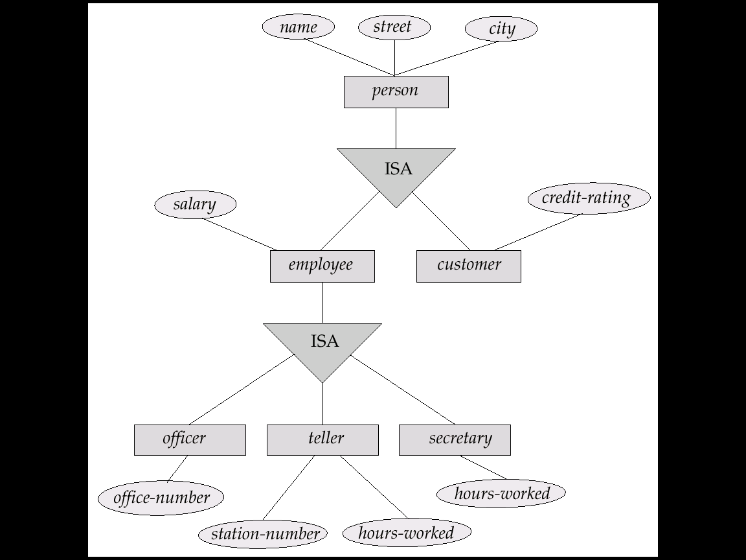
Example

Slide 55
Generalization（泛化）
A bottom-up design process (自下而上的设计过程)
Combine a number of entity sets that share the same features into a higher-level entity set
Specialization (特化), Generalization (泛化)
Specialization and generalization are simple inversions of each other
They are represented in the same way in an E-R diagram

Slide 56
Specialization & Generalization (Cont.)
Can have multiple specializations of an entity set based on different features.
E.g., permanent-employee vs. temporary-employee, in addition to officer vs. secretary vs. teller
Each particular employee would be
a member of one of permanent-employee or temporary-employee,
and also a member of one of officer, secretary, or teller
The ISA relationship also referred to as superclass - subclass relationship
Notes:
The way we depict specialization in an E-R diagram depends on whether an entity may belong to multiple specialized entity sets or if it must belong to at most one specialized entity set. The former case (multiple sets permitted) is called overlapping specialization, while the latter case (at most one permitted) is called disjoint specialization.

Slide 57
Design Constraints on a Specialization/Generalization
Constraint on which entities can be members of a given lower-level entity set
condition-defined (attribute-defined)
user-defined
Constraint on whether or not entities may belong to more than one lower-level entity set within a single generalization
Disjoint
Overlapping

Slide 58
Design Constraints on a Specialization/Generalization (Cont.)
Completeness constraint - specifies whether or not an entity in the higher-level entity set must belong to at least one of the lower-level entity sets within a generalization.
total : an entity must belong to one of the lower-level entity sets
partial: an entity need not belong to one of the lower-level entity sets

Slide 59
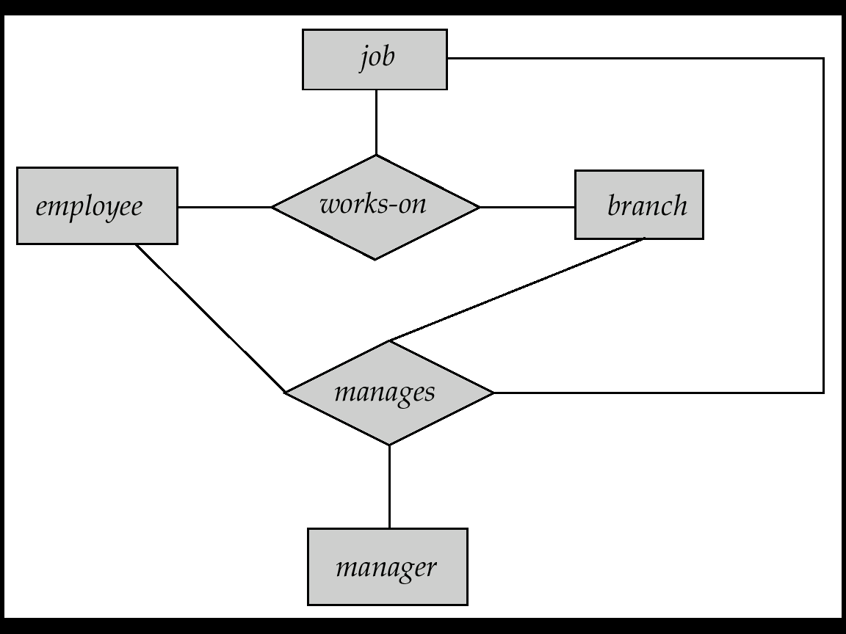
Aggregation (聚合)
Consider the ternary relationship works-on, which we saw earlier
Suppose we want to record managers for tasks performed by an employee at a branch

Slide 60
Aggregation (Cont.)
Relationship sets works-on and manages represent overlapping information
Eliminate this redundancy via aggregation
Treat relationship as an abstract entity
Allows relationships between relationships
Without introducing redundancy, the following diagram represents:
An employee works on a particular job at a particular branch
An employee, branch, job combination may have an associated manager

Slide 61
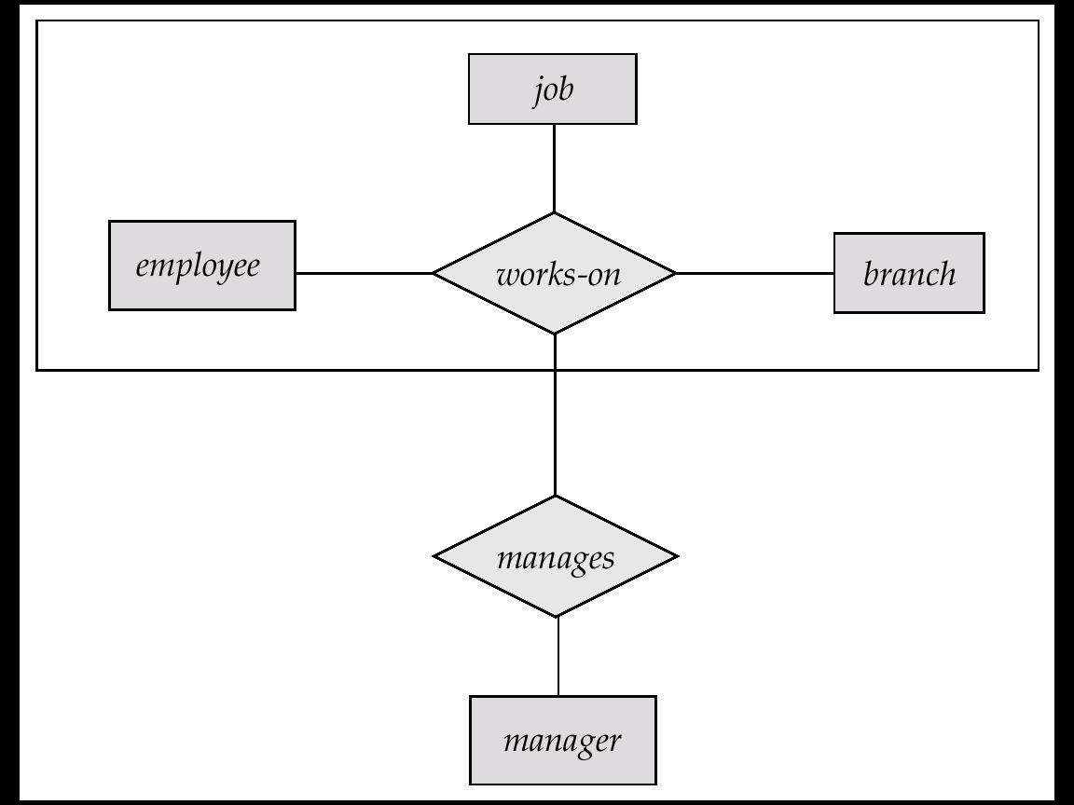
E-R Diagram With Aggregation
A higher-level entity set called works_on

Slide 62
E-R Design Decisions
The use of an attribute or entity set to represent an object
Whether a real-world concept is best expressed by an entity set or a relationship set
The use of a ternary relationship versus a pair of binary relationships
The use of a strong or weak entity set
The use of specialization/generalization – contributes to modularity in the design
The use of aggregation – can treat the aggregate entity set as a single unit without concern for the details of its internal structure

Slide 63
Database Design Phases
Requirements Analysis
Conceptual Design (E-R Model)
Functional Requirements Analysis
Describe the operations that will be performed on the data
Review the design
Logical Implementation
Mapping from conceptual model to implementation model
Such as relational model, OO model
Physical Implementation
Specify physical features of the database
buffer size, index…

Slide 64
E-R Diagram for a Banking Enterprise
account-branch

Slide 65
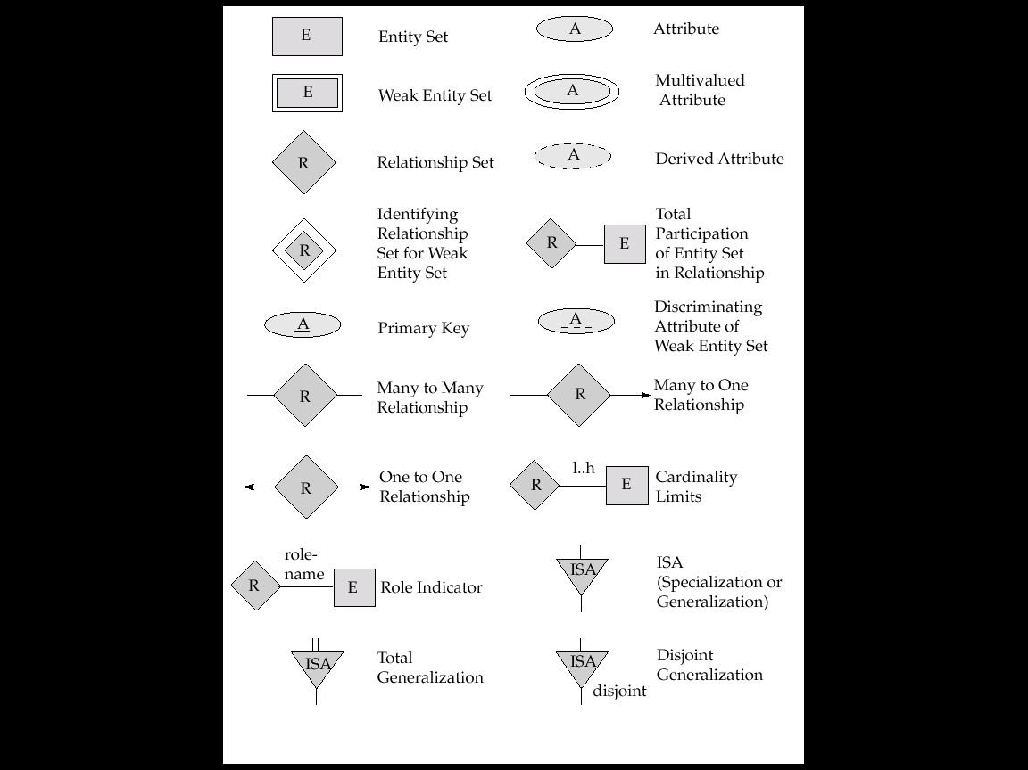
Summary of Symbols Used in E-R Notation

Slide 66
Summary of Symbols (Cont.)

Slide 67
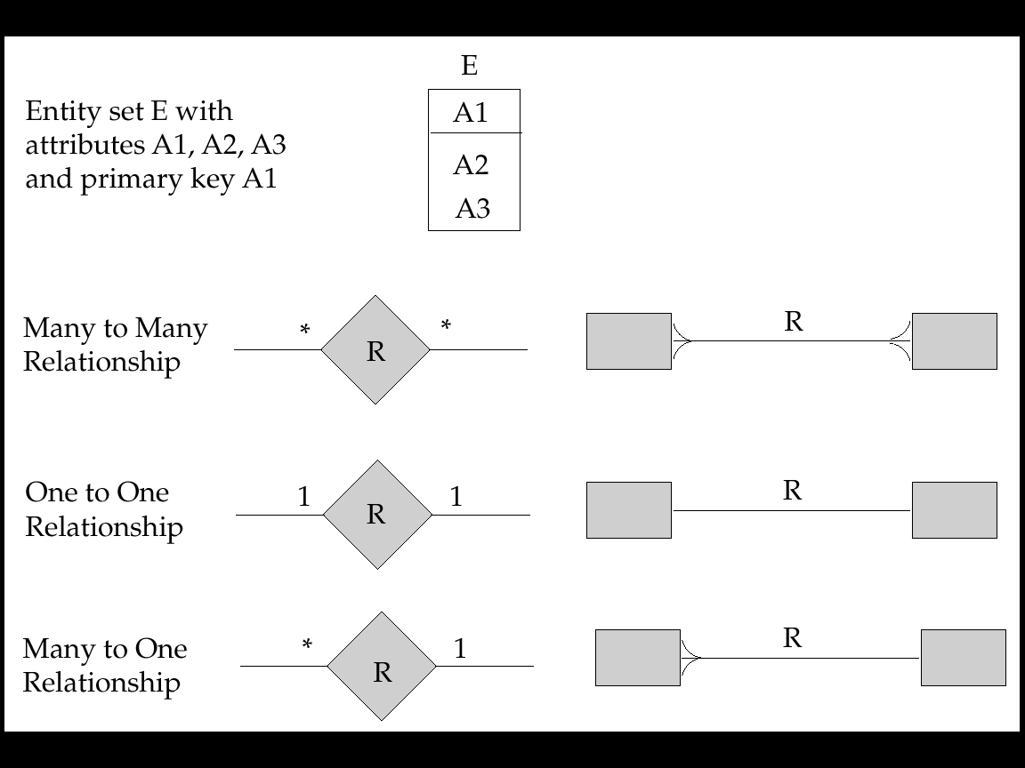
Alternative E-R Notations

Slide 68
Outline
Overview of the Design Process
Entity-Relationship Model (实体联系模型)
Constraints
Entity-Relationship Diagrams (实体联系图)
☞ Reduction to Relation Schemas
Summary

Slide 69
Reduction to Relational Schemas
Reduction of an E-R Diagram to Tables
For each entity set and relationship set there is a unique table.
Each table has a number of columns
Converting an E-R diagram to a table format is the basis for deriving a relational database design from an E-R diagram
Primary keys allow entity sets and relationship sets to be expressed uniformly as tables which represent the contents of the database

Slide 70
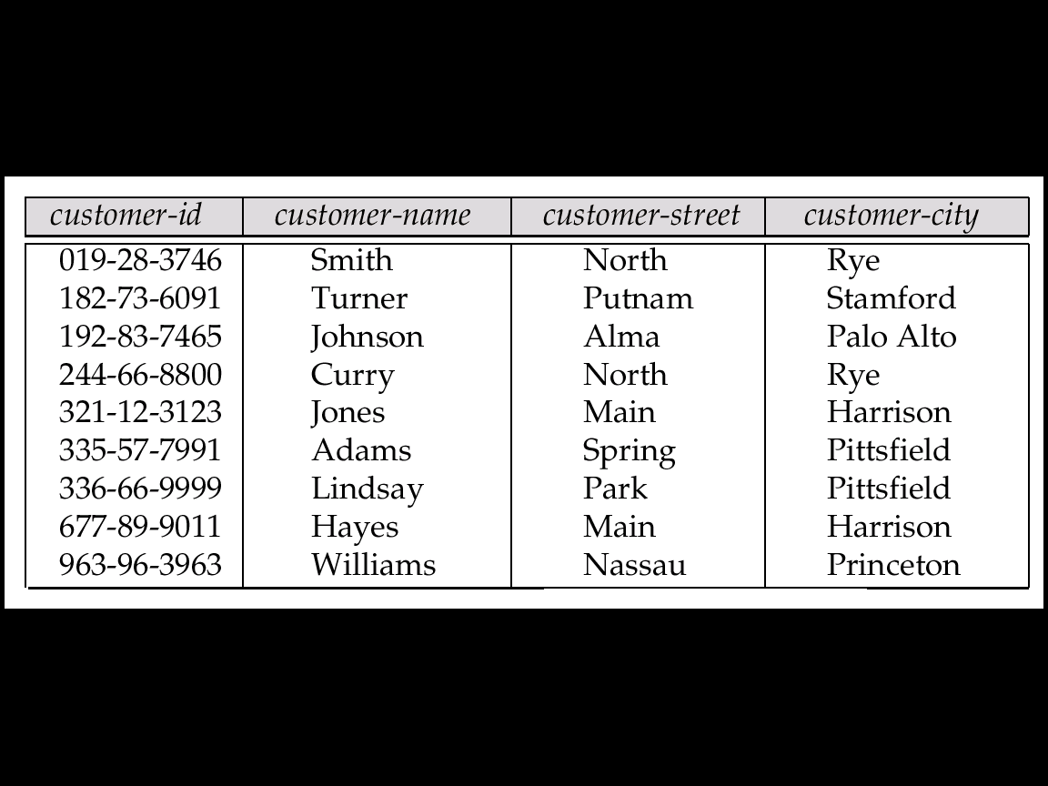
Representing Entity Sets as Tables
A strong entity set reduces to a table with the same attributes

Slide 71
Composite and Multi-valued Attributes
Composite attributes are flattened out by creating a separate attribute for each component attribute
A multi-valued attribute M of an entity E is represented by a separate table EM
Table EM has attributes corresponding to the primary key of E and an attribute corresponding to multivalued attribute M
Each value of the multivalued attribute maps to a separate row of the table EM
Notes:
if we had an instructor with ID 22222, and phone numbers 555-1234 and 555-4321, the relation instructor phone would have two tuples (22222, 555-1234) and (22222, 555-4321).

Slide 72
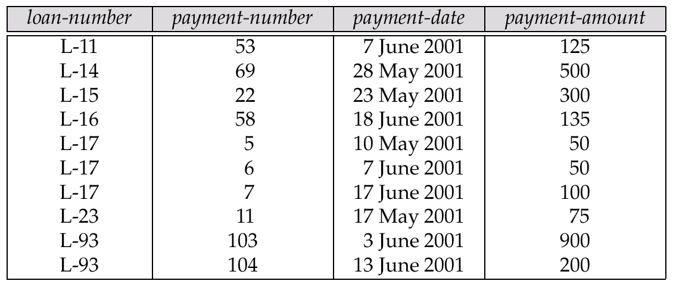
Representing Weak Entity Sets
A weak entity set becomes a table that includes a column for the primary key of the identifying strong entity set
Notes:
identifying ：识别

Slide 73
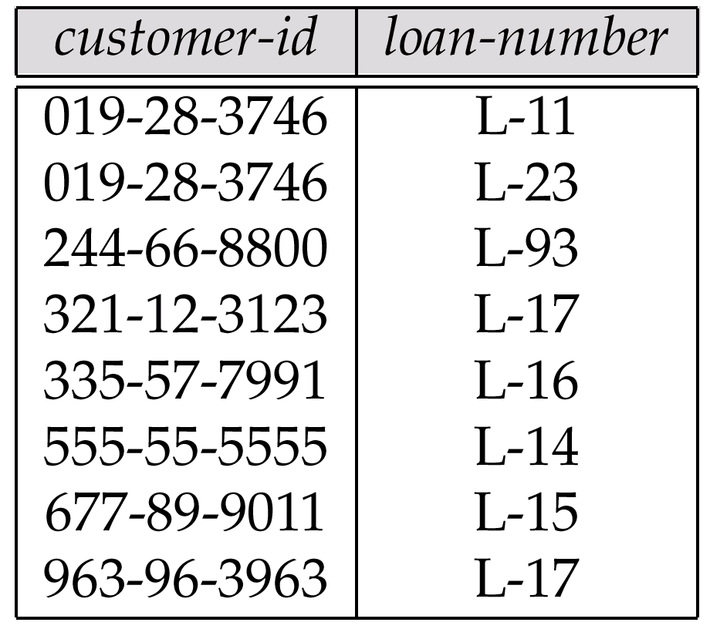
Representing Relationship Sets as Tables
Many-to-many relationship set
Represented as a table with columns for the primary keys of the two participating entity sets, and any descriptive attributes of the relationship set.
E.g.: table for relationship set borrower

Slide 74
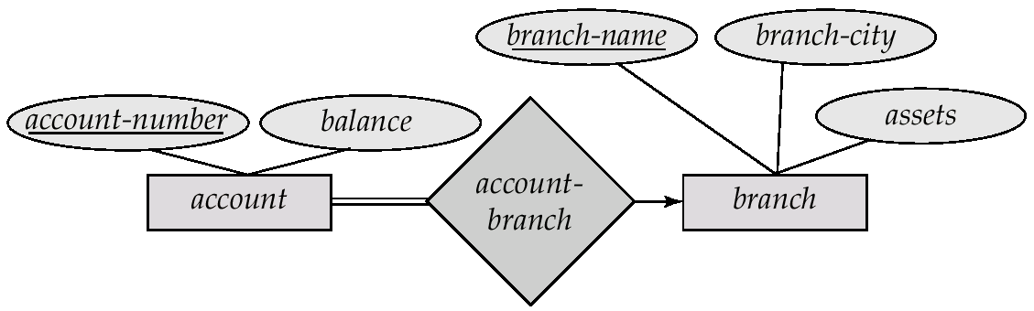
Representing Relationship Sets as Tables
Many-to-one and one-to-many relationship sets
Can be represented by adding an extra attribute to the many side, containing the primary key of the one side
E.g.: instead of creating a table for relationship account-branch, add an attribute branch-name to the entity set account
many side
one side

Slide 75
Representing Relationship Sets as Tables
One-to-one relationship sets
either side can be chosen to act as the “many” side
If participation is partial on the many side, it could result in null values
The table corresponding to a relationship set linking a weak entity set to its identifying strong entity set is redundant

Slide 76
Representing Specialization as Tables
Method 1:
Form a table for the higher level entity
Form a table for each lower level entity set, include primary key of higher level entity set and local attributes
table table attributes person name, street, city customer name, credit-rating employee name, salary
Drawback: Querying information about entities, e.g., employee, requires accessing two tables

Slide 77
Representing Specialization as Tables (Cont.)
Method 2:
Form a table for each entity set with all local and inherited attributes
table table attributes person name, street, city customer name, street, city, credit-rating employee name, street, city, salary
Drawback: street and city may be stored redundantly for persons who are both customers and employees
If specialization is total, table for generalized entity (person) not required to store information

Slide 78
Relations Corresponding to Aggregation
To represent aggregation, create a table containing
primary key of the aggregated relationship,
the primary key of the associated entity set
Any descriptive attributes
E.g. to represent aggregation manages between relationship works-on and entity set manager, create a table
manages(employee_id, branch_name, title, manager_name)
Table works-on is redundant provided we are willing to store null values for attribute manager_name in table manages

Slide 79
E-R Diagram for a Banking Enterprise
account-branch
Weak entity sets
multi-valued attribute
derived attribute

Slide 80
The Banking Schema
branch = (branch_name, branch_city, assets)
customer = (customer_id, customer_name, customer_street, customer_city)
loan = (loan_number, amount)
account = (account_number, balance)
employee = (employee_id, employee_name, telephone_number, start_date) (derived attribute not included)
dependent_name = (employee_id, dname) (derived from a multivalued attribute)
account_branch = (account_number, branch_name)
loan_branch = (loan_number, branch_name)
borrower = (customer_id, loan_number)
depositor = (customer_id, account_number, access_date)
cust_banker = (customer_id, employee_id, type)
works_for = (worker_employee_id, manager_employee_id)
payment =(loan_number,payment_number,payment_date,payment_amount) (weak entity set)
savings_account = (account_number, interest_rate) (ISA specialization)
checking_account = (account_number, overdraft_amount) (ISA specialization)

Slide 81
Outline
Overview of the Design Process
Entity-Relationship Model (实体联系模型)
Constraints
Entity-Relationship Diagrams (实体联系图)
Reduction to Relation Schemas
☞ Summary

Slide 82
Database Design Phases
Requirements Analysis
Conceptual Design (E-R Model)
Functional Requirements Analysis
Describe the operations that will be performed on the data
Review the design
Logical Implementation
Mapping from conceptual model to implementation model
E.g., relational model, OO model
Physical Implementation
Specify physical features of the database
buffer size, index…
Notes:
OO：面向对象

Slide 83
Symbols Used in E-R Diagrams

Slide 84
Symbols Used in E-R Diagrams (Cont.)

Slide 85
Design Tools
Rational Rose
http://www-306.ibm.com/software/rational/
Visio Enterprise
http://www.microsoft.com/china/office/xp/visio/default.asp
Erwin
http://www3.ca.com/Solutions/Product.asp?ID=260
Power Designer
http://www.sybase.com/products/developmentintegration/powerdesigner

Slide 86
Summary of ER Model
Conceptual design follows requirements analysis
Yields a high-level description of data to be stored
E-R model is popular for conceptual design
Constructs are expressive, close to the way people think about their applications
Basic constructs: entities, relationships, and attributes (of entities and relationships)
Some additional constructs: weak entities, ISA hierarchies
Note: There are many variations on ER model

Slide 87
Summary of ER Model (Cont.)
Integrity constraints in E-R model
key constraints, participation constraints, and overlap/covering constraints for ISA hierarchies. Some foreign key constraints are also implicit in the definition of a relationship set
Some constraints (notably, functional dependencies) cannot be expressed in the E-R model
Constraints play an important role in determining the best database design for an enterprise

Slide 88
Summary of ER Model
ER design is subjective
There are often many ways to model a given scenario! Analyzing alternatives can be tricky, especially for a large enterprise. Common choices include:
Entity vs. attribute, entity vs. relationship, binary or n-ary relationship, whether or not to use ISA hierarchies
Ensuring good database design
The generated relational schema should be analyzed and refined further
FD information and normalization techniques are especially useful (《数据库系统概念》第7章)
Notes:
FD :Functional Dependencies

Slide 89
补充练习
书店管理应用包含三个实体集
Bookstore: BSName, BSaddress, BSTel, BSManager
Book: BookNo, BName, BPrice, Author, Publisher, PublishYear, Version
Warehouse：WNo, WName, WAddress, Wadministrator
两个关系集
Sale (Bookstore and Book): SaleDate and SaleQuantity
Stock (Book and Warehouse)：InDate, InPrice, and StockQuantity
问题: 给出对应的ER图和关系模式，并指出主码和外码

Slide 90
ER图
BookNo
WName
BSaddress
BPrice
InDate
SaleDate
BSname
WNo
BName
Bookstore
Sale
Book
Stock
Warehouse
Author
Publisher
InPrice
Wadministrator
BSTel
SaleQuantity
BSManager
PublishYear
Version
StockQuantity
WAddress

Slide 91
关系模式
Relation schemas & primary keys
Bookstore (BSName, BSaddress, BSTel, BSManager)
Book (BookNo, BName, BPrice, Author, Publisher, PublishYear, Version)
Warehouse (WNo, WName, WAddress, Wadministrator)
Sale (BSName, BookNo, SaleDate, SaleQuantity)
Stock (BookNo, WNo, InDate, InPrice, StockQuantity)
Foreign keys
Sale references Bookstore and Book on BSName and BookNo, respectively
Stock reference Book and Warehouse on BookNo and WNo, respectively

Slide 92
End of Lecture 6

